Slide 1

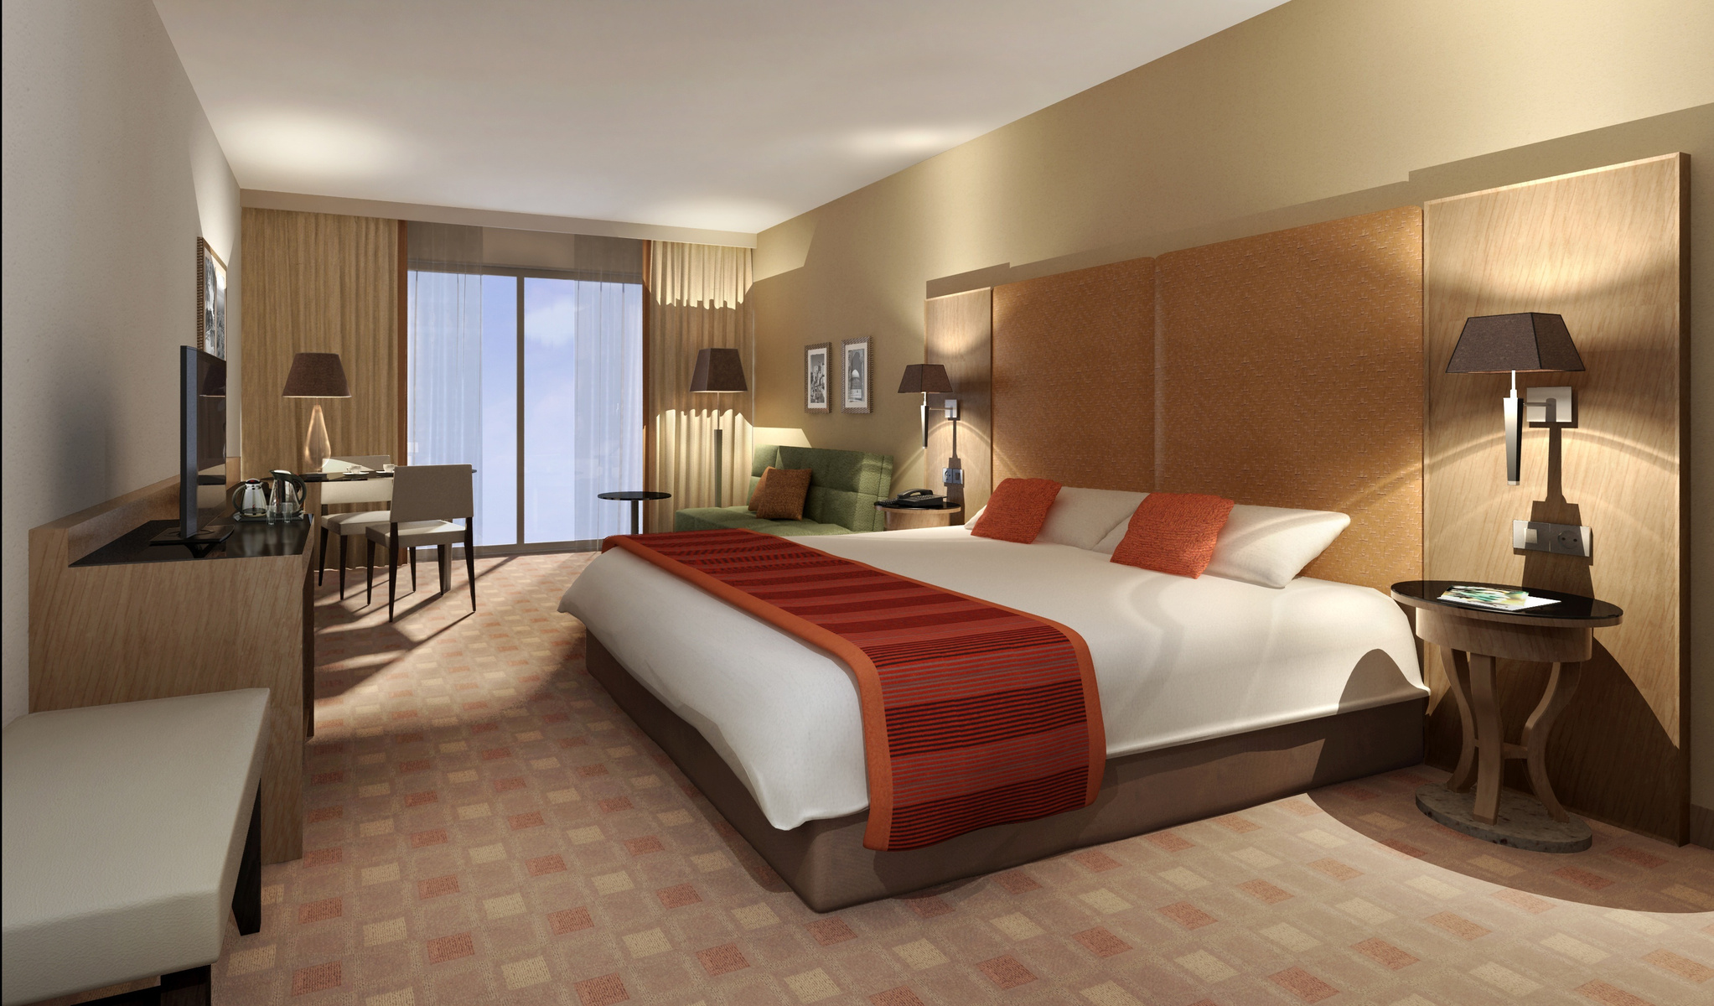
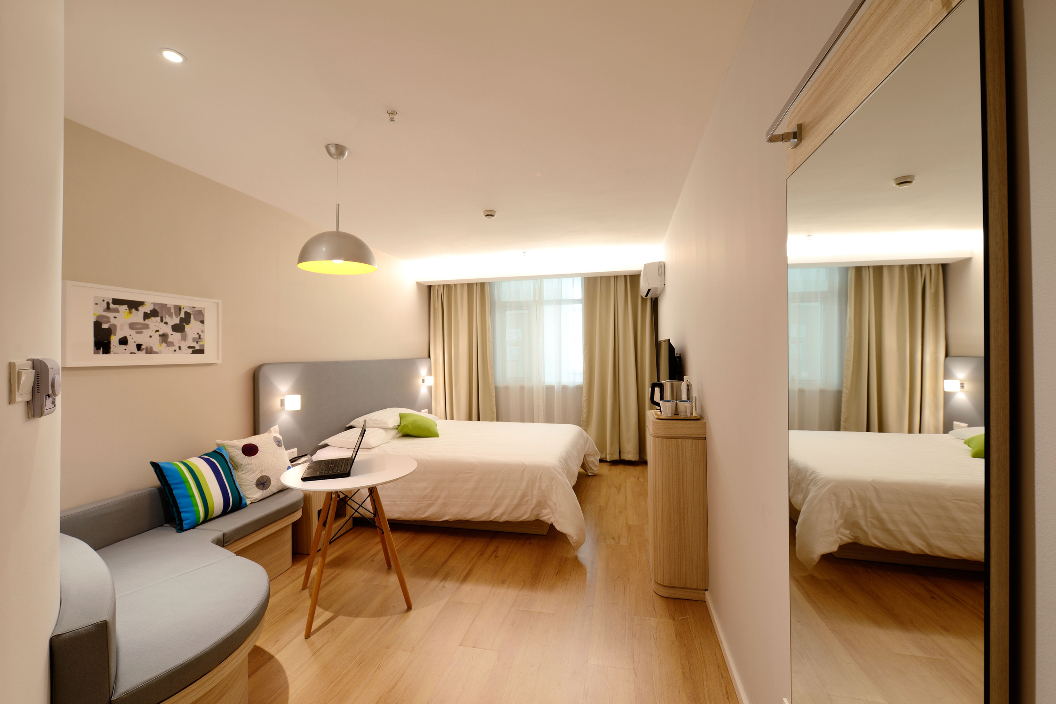
Hotel
Reservation
Analysis
using SQL

Slide 2

Overview
The hotel industry relies on data to make informed decisions and provide a better guest experience. In this project, I worked with a hotel reservation dataset to gain insights into guest preferences, booking trends, and other key factors that impact the hotel's operations. Used SQL to query and analyze the data, as well as answer specific questions about the dataset.

Slide 3
Booking_ID: A unique identifier for each hotel reservation.
no_of_adults: The number of adults in the reservation.
no_of_children: The number of children in the reservation.
no_of_weekend_nights: The number of nights in the reservation that fall on weekends.
no_of_week_nights: The number of nights in the reservation that fall on weekdays.
type_of_meal_plan: The meal plan chosen by the guests.
room_type_reserved: The type of room reserved by the guests.
lead_time: The number of days between booking and arrival.
arrival_date: The date of arrival.
market_segment_type: The market segment to which the reservation belongs.
avg_price_per_room: The average price per room in the reservation.
booking_status: The status of the booking.
Dataset Details

Slide 4
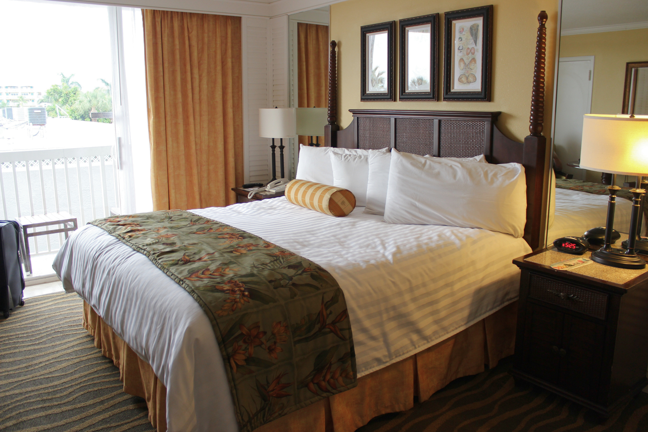
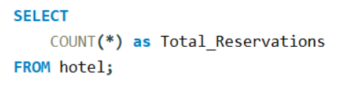
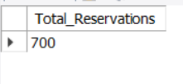
1. What is the total number of reservations in the dataset?

Slide 5
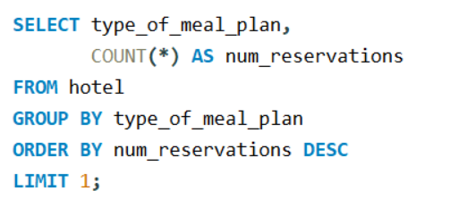
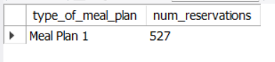
2. Which meal plan is the most popular among guests?

Slide 6
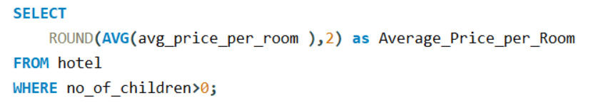
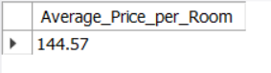
3. What is the average price per room for reservations involving children?

Slide 7
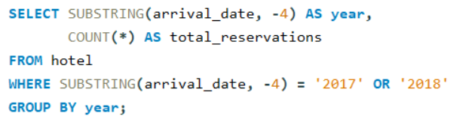
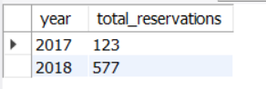
4. How many reservations were made for the year 20XX (replace XX with the desired year)?

Slide 8
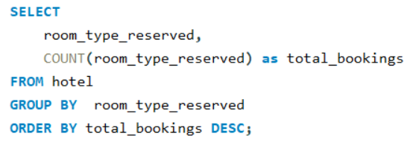
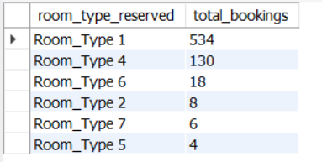
5. What is the most commonly booked room type?

Slide 9
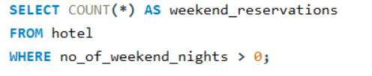
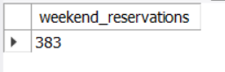
6. How many reservations fall on a weekend (no_of_weekend_nights > 0)?

Slide 10
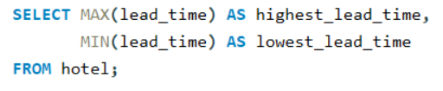
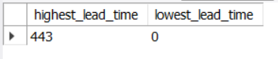
7. What is the highest and lowest lead time for reservations?

Slide 11
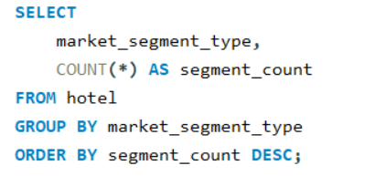
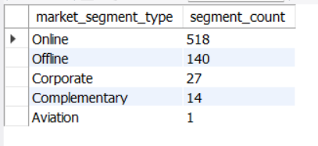
8. What is the most common market segment type for reservations?

Slide 12
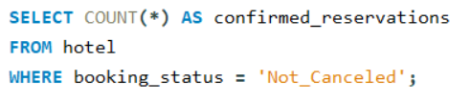
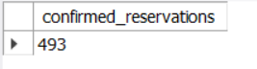
9. How many reservations have a booking status of "Confirmed"?

Slide 13
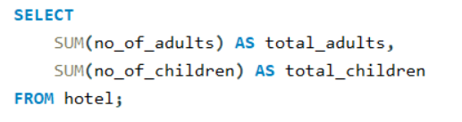
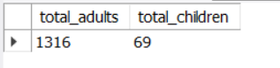
10. What is the total number of adults and children across all reservations?

Slide 14
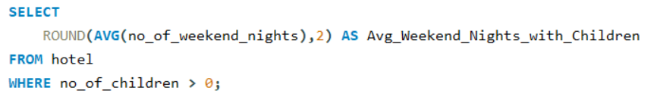
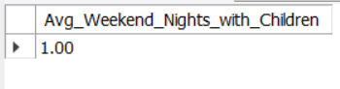
11. What is the average number of weekend nights for reservations involving children?

Slide 15
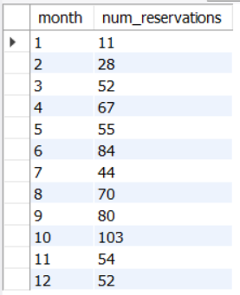
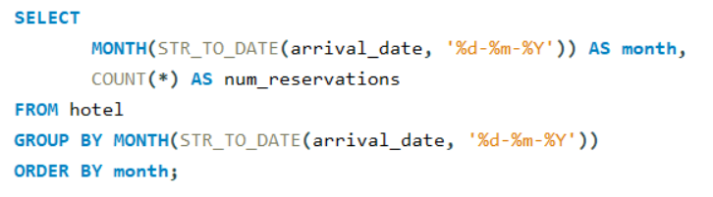
12. How many reservations were made in each month of the year?

Slide 16
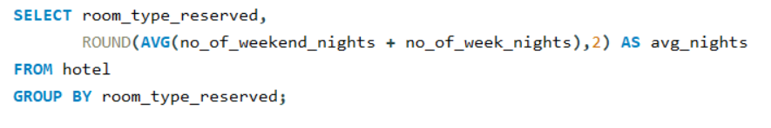
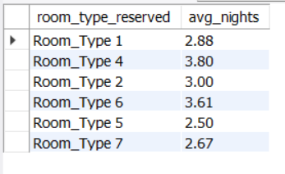
13. What is the average number of nights (both weekend and weekday) spent by guests for each room type?

Slide 17
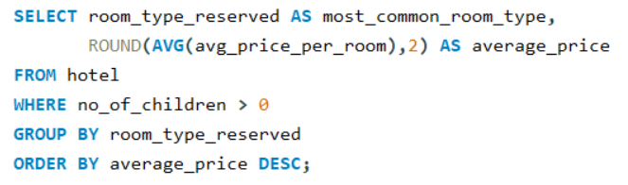
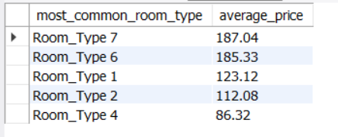
14. For reservations involving children, what is the most common room type, and what is the average price for that room type?

Slide 18
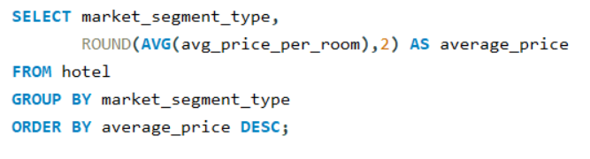
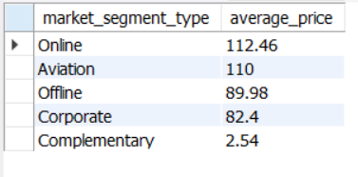
15. Find the market segment type that generates the highest average price per room.

Slide 19
Thank
You!

